Slide 1
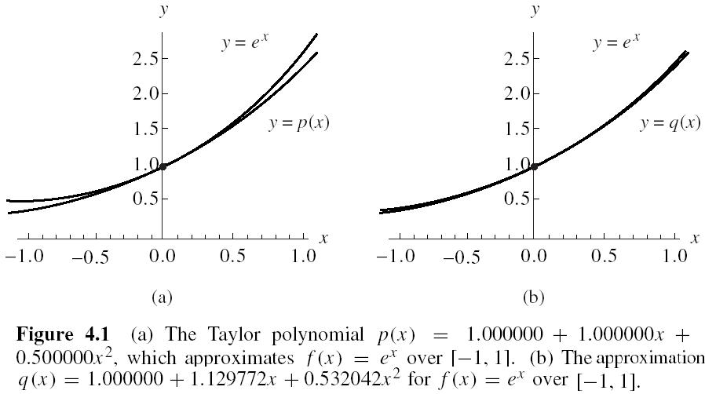
Interpolation and Polynomial Approximation (p187)

Slide 2
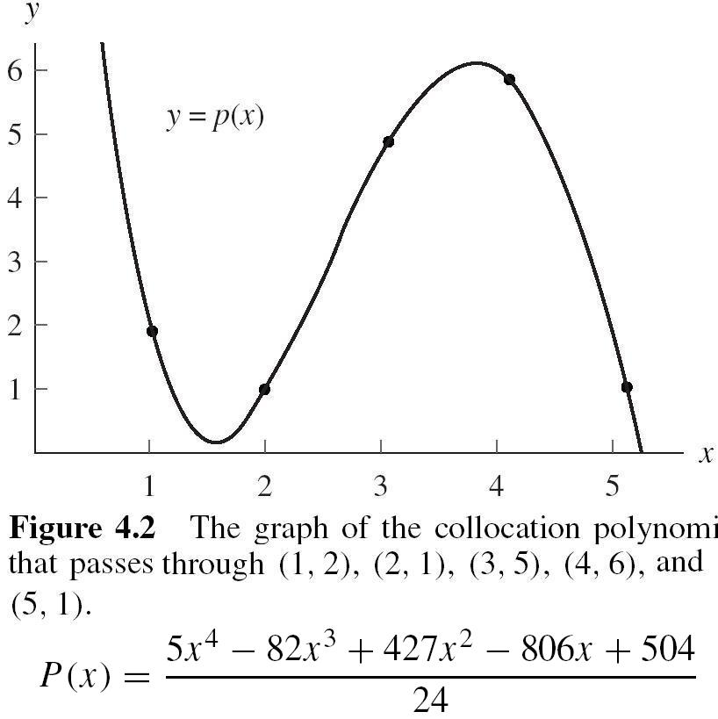

Slide 3
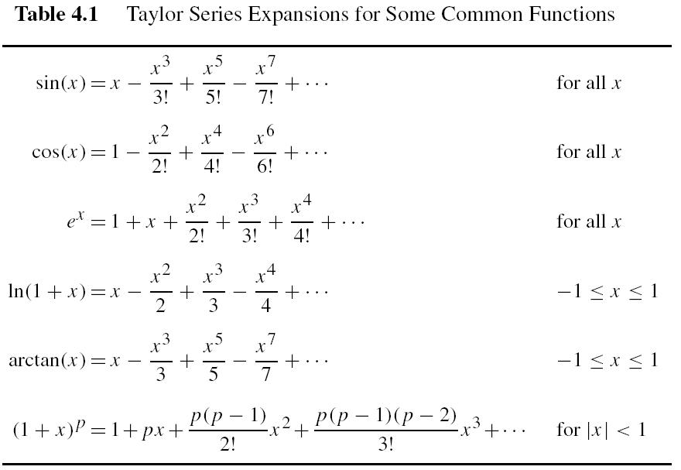

Slide 4
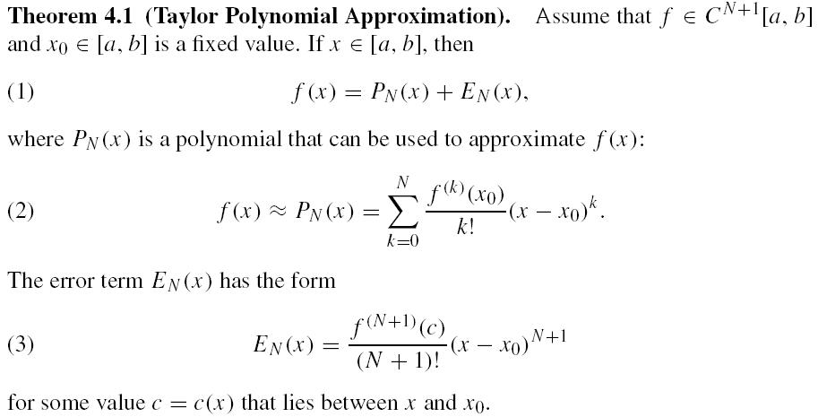
Page 189

Slide 5
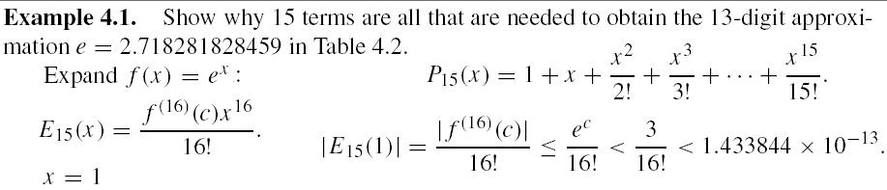
Reading
Page 190 – Example 4.1

Slide 6
Reading
Pages 192 & 193 – Examples 4.2 & 4.3
Home Assignment
Page 195 – Exercises 1(b) & 2(b)

Slide 7
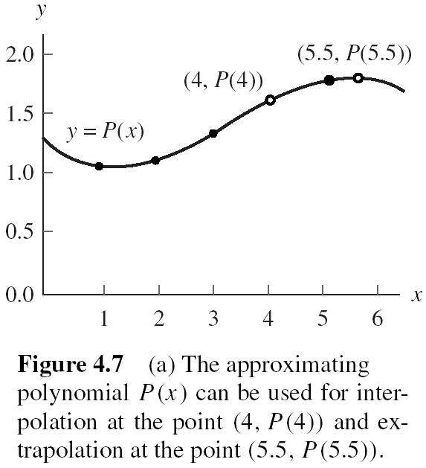
Polynomial Approximation (p200)

Slide 8
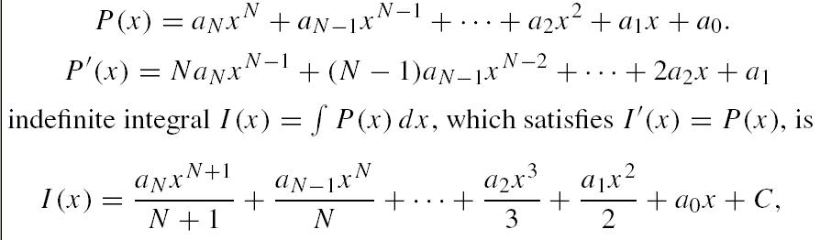

Slide 9
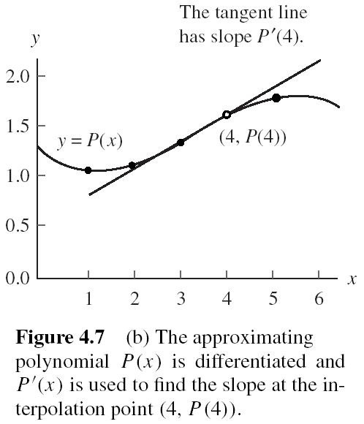

Slide 10
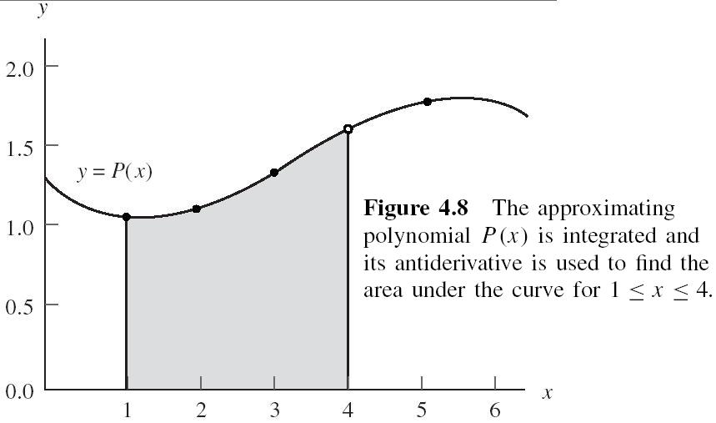

Slide 11
Reading
Page 200 – Example 4.4
Home Assignment
Page 205 – Exercise 2

Slide 12
Different from previous method (using system of linear equation to calculate the polynomial coefficients), we could directly give the coefficients without derivation:
-- Lagrange Polynomial
-- Newton Polynomial

Slide 13

Lagrange Approximation
The French mathematician Lagrange noticed
which passes through (x0,y0) and (x1,y1).
Lagrange linear polynomial

Slide 14
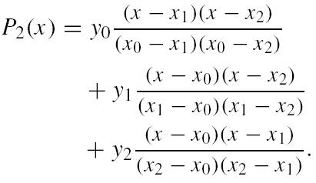
Lagrange quadratic interpolating polynomial
Page 210
which passes through (x0,y0), (x1,y1), and (x2,y2).

Slide 15
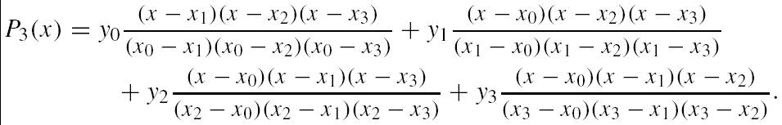
Lagrange cubic interpolating polynomial
which passes through (x0,y0), (x1,y1), (x2,y2), and (x3,y3).

Slide 16
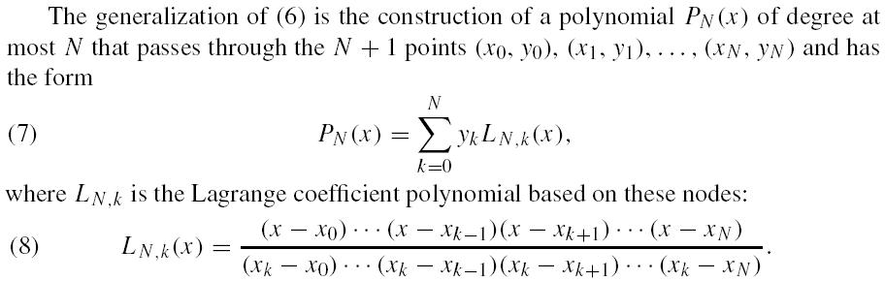
The general form of Lagrange interpolating polynomial (p208)

Slide 17
Reading
Page 207 – Example 4.6
Page 210 – Example 4.7
Home Assignment
Page 217 – Exercises 1 and 2

Slide 18
Interpolation
Newton’s Divided Difference Polynomial Method

Slide 19
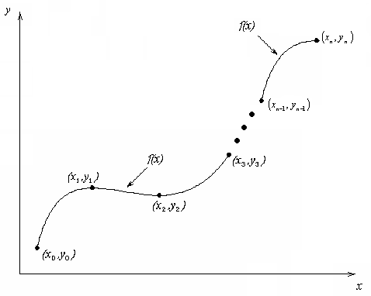
What is Interpolation ?
Given (x₀,y₀), (x₁,y₁), …… (x_{n},y_{n}), find the value of ‘y’ at a value of ‘x’ that is not given.

Slide 20

Interpolants
Polynomials are the most common choice of interpolants because they are easy to:
  Evaluate
  Differentiate, and
  Integrate.

Slide 21



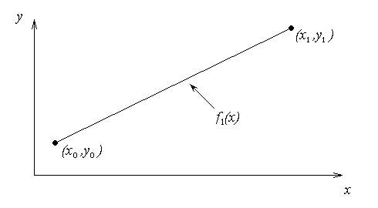

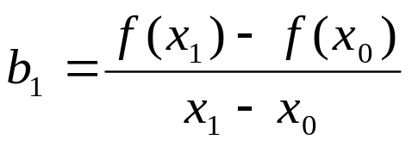
Newton’s Divided Difference Method
Linear interpolation: Given pass a linear interpolant through the data
where

Slide 22
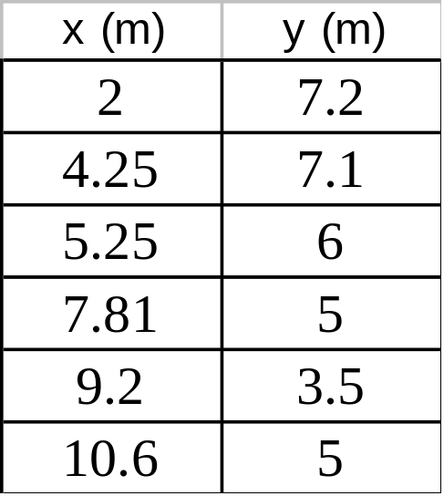
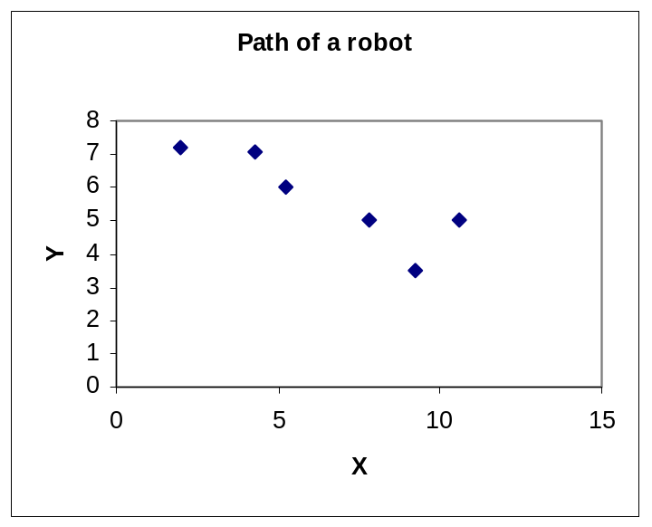
Example
The path of a rapid laser is given by these specifications.
If the laser is traversing from x = 2 to x = 4.25 in a
linear path, find the value of y at x = 4 using the Newton’s Divided difference polynomial method.

Slide 23
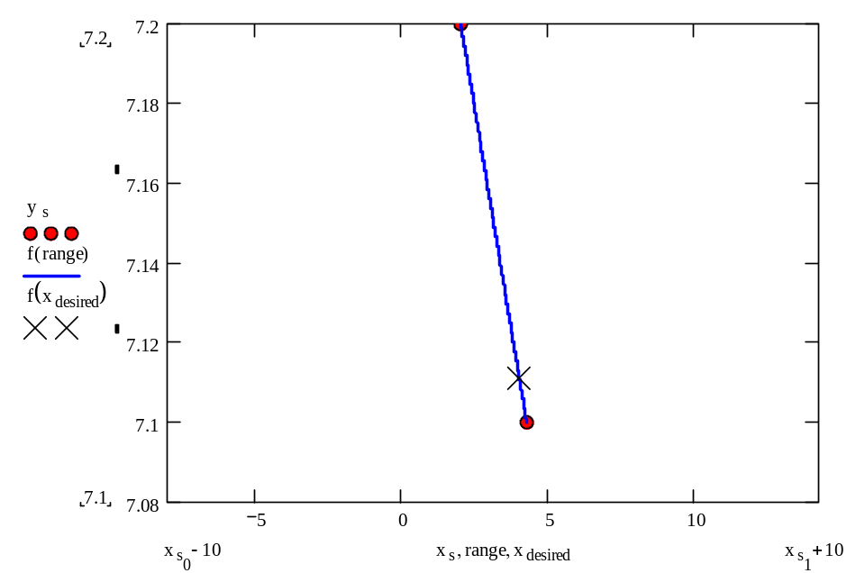
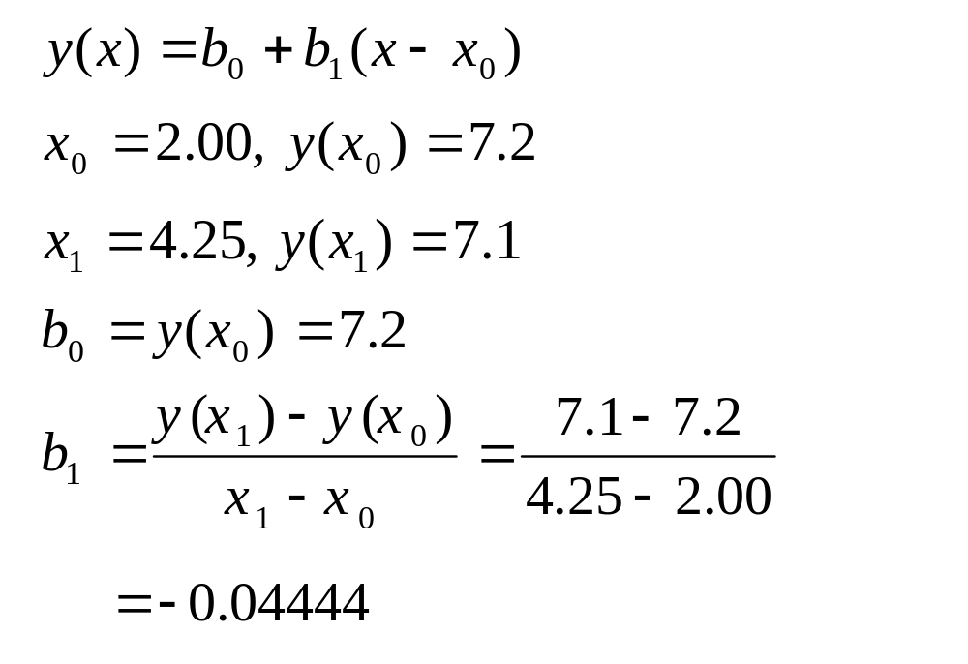
Linear Interpolation

Slide 24
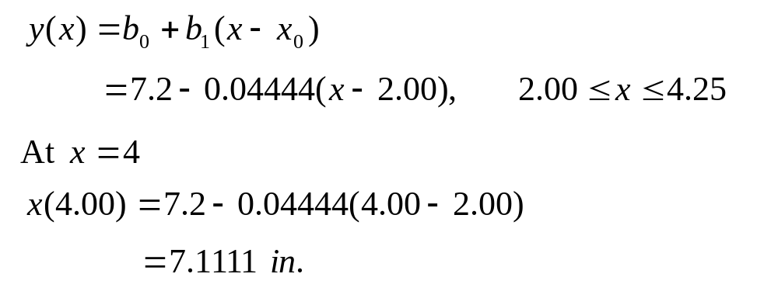
Linear Interpolation (contd)

Slide 25

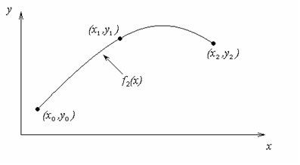
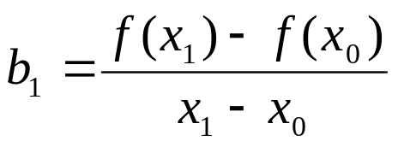
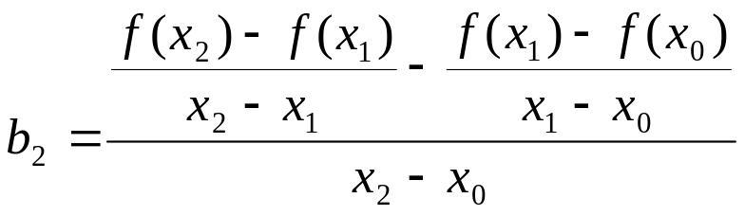
Quadratic Interpolation
注意：与数值微分的关系！

Slide 26
Example
The path of a rapid laser is given by these specifications.
If the laser is traversing from x = 2 to x = 4.25 to x=5.25 using a quadratic path, find the value of y at x = 4 using the Newton’s Divided difference polynomial method.

Slide 27
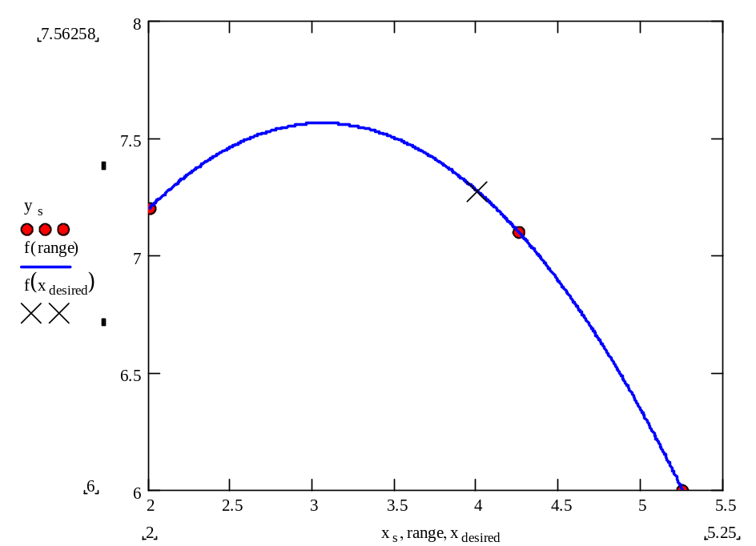
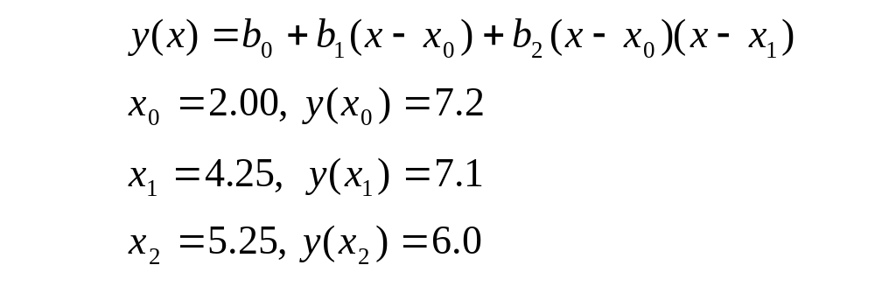
Quadratic Interpolation (contd)

Slide 28
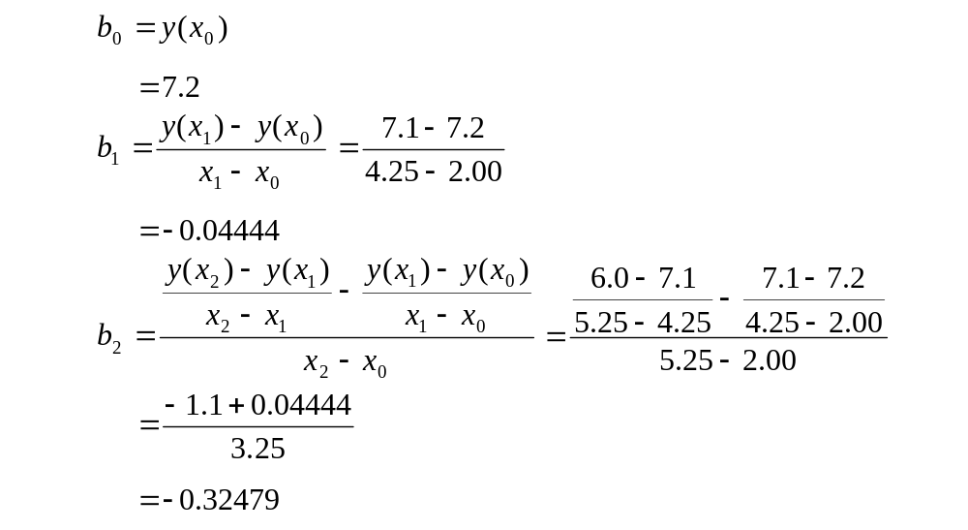
Quadratic Interpolation (contd)

Slide 29
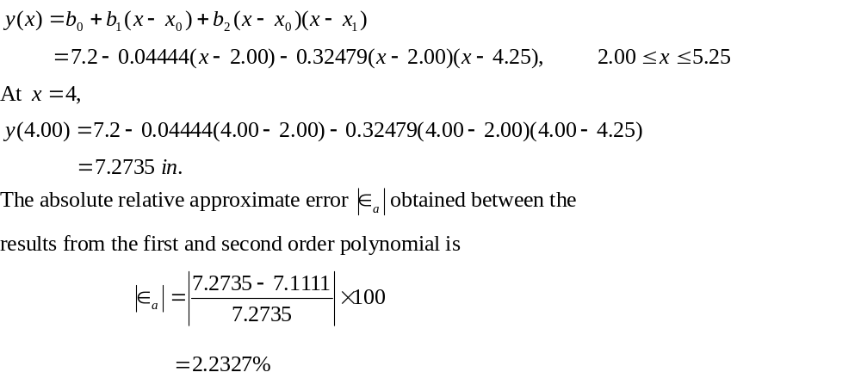
Quadratic Interpolation (contd)

Slide 30
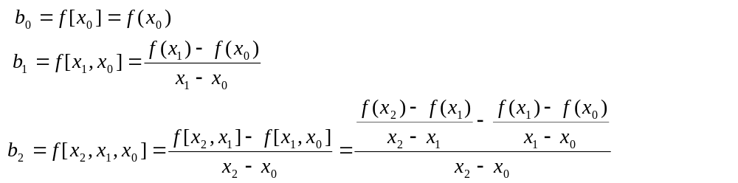
General Form
where
Rewriting

Slide 31
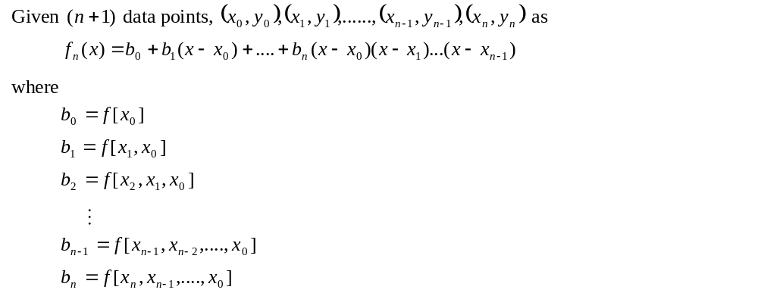
General Form

Slide 32
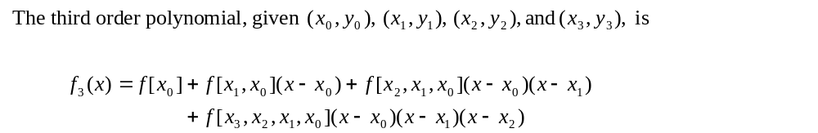
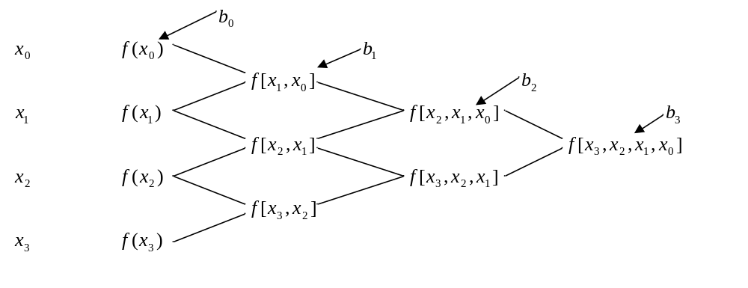
General form

Slide 33
Example
The path of a rapid laser is given by these specifications. Find the path traversed by the laser using the Newton’s Divided Difference Polynomial method.

Slide 34
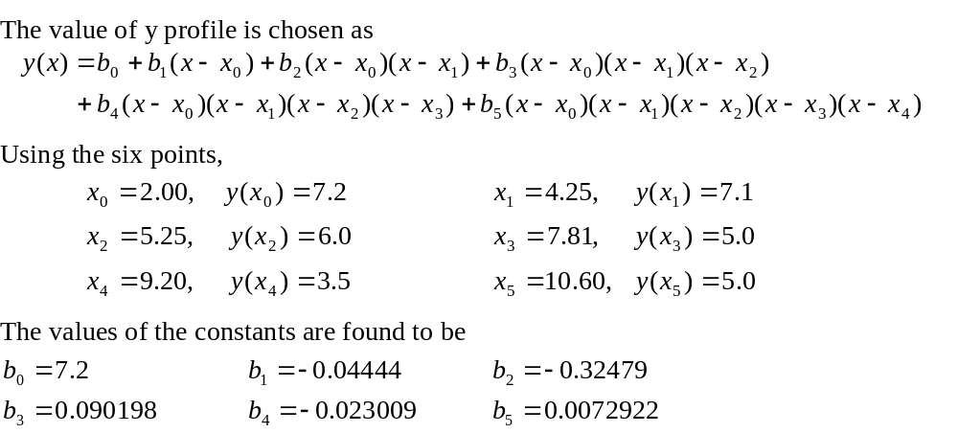
Example

Slide 35

Example

Slide 36
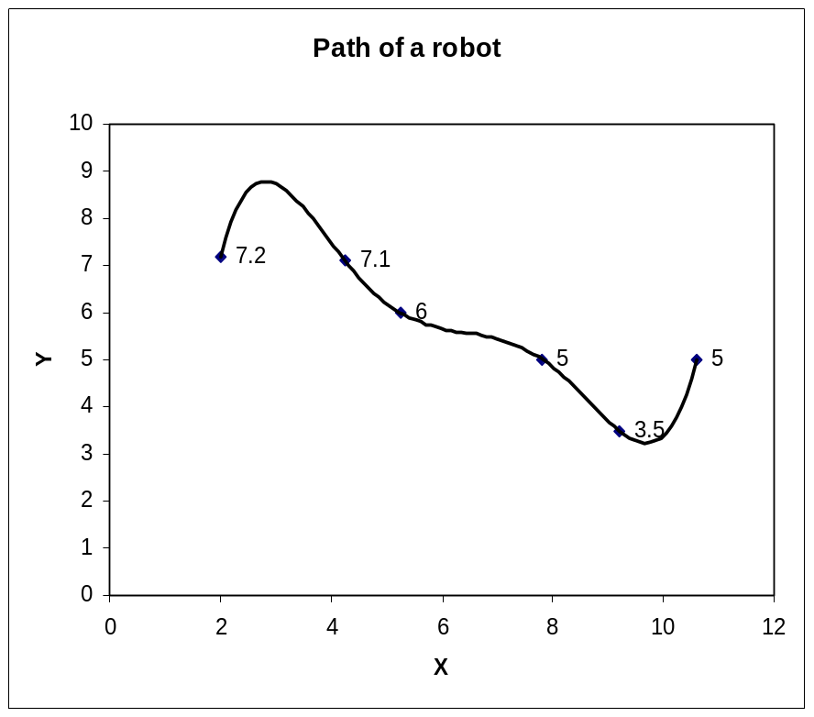
Example

Slide 37
Reading
Page 225 – Example 4.12
Home Assignment
Page 229 – Exercise 7

